Slide 1
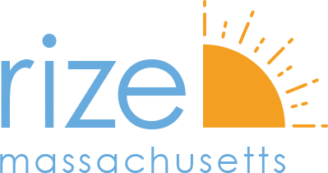
Mass. & Cass Reconciliation Program
RFI Information Session
April 13, 2022 | 12:00 pm- 1:00 pm

Slide 2
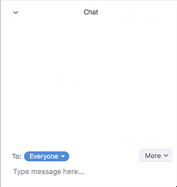
Welcome!
We’ll get started in just a few minutes.
Audio is available through your computer speakers or by calling in via phone.
To change your audio source or troubleshoot an issue, click the ^ button, and select a different source for your speaker or microphone.
To view the meeting’s live transcript, click the CC icon and select from the following:
Feel free to introduce yourself
by typing your name
and where you are joining us from
in the chat box.
Notes:
Tech support

Slide 3
Mass. & Cass – A Neighborhood at a Crossroads
For several years, Mass. and Cass has seen a significant increase in SUD and homeless services to meet the growing population of people using drugs and accessing care in the area.
This, combined with the trauma of increased deaths and quality of life concerns, has caused a great deal of conflict in the neighborhood. Those most affected have been:
Frontline Public Health Workers
Drug Users and People Experiencing Homelessness
First Responders
Homeowners and Renters
Business Owners

Slide 4
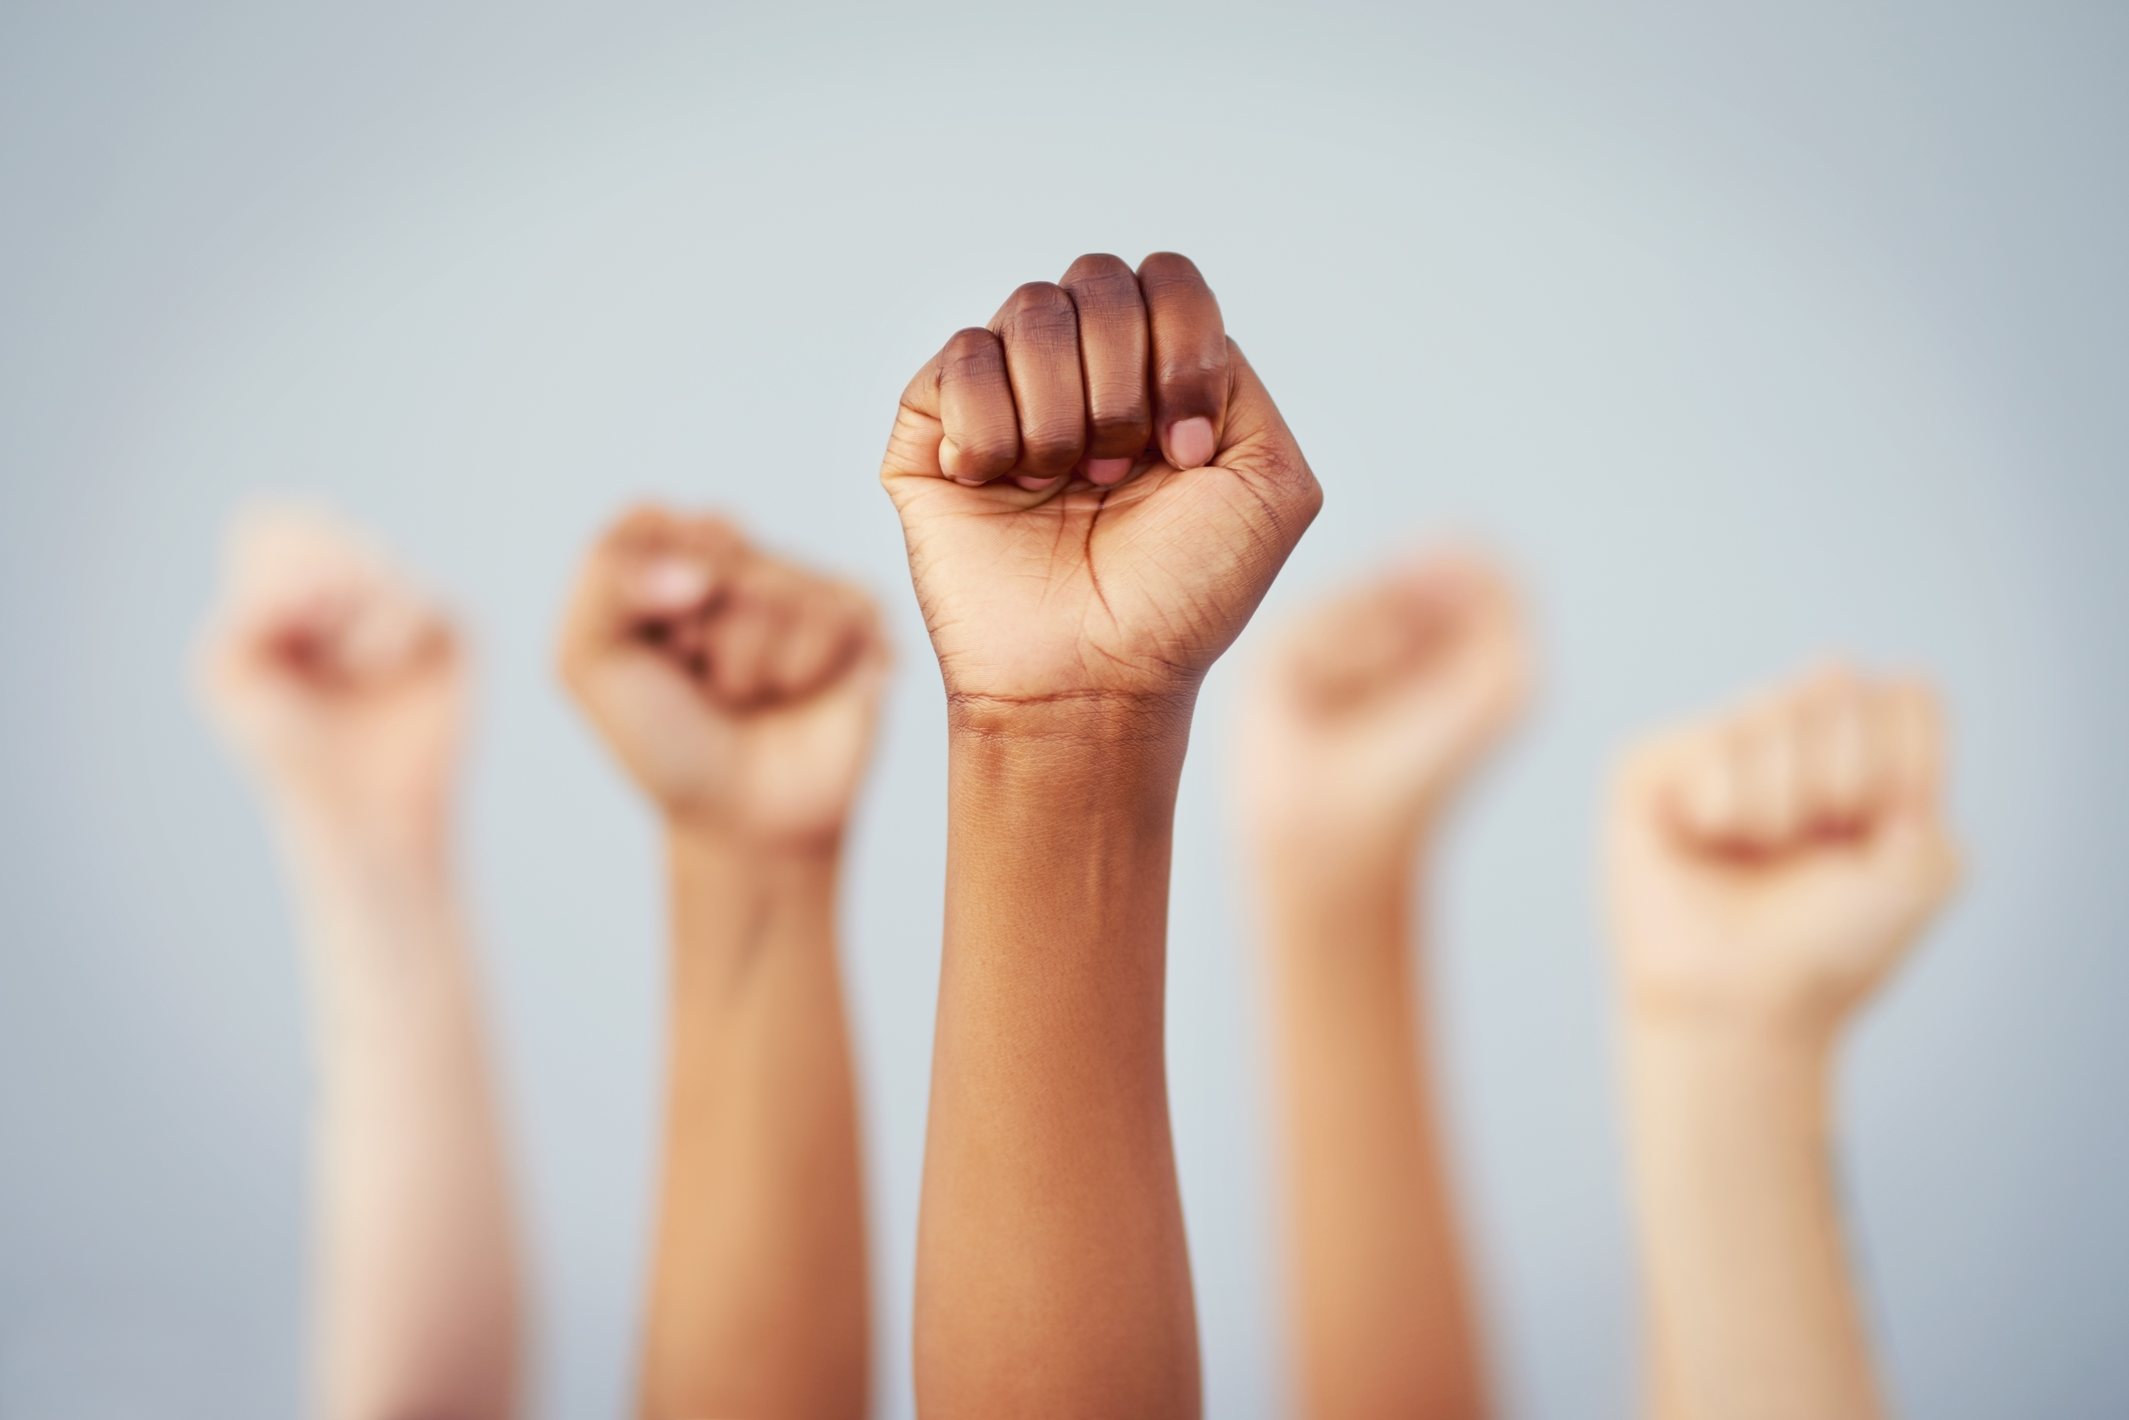
Mass. & Cass – Community Reconciliation Project
RIZE plans to partner with a community reconciliation expert and Mass. and Cass community stakeholders to develop a lasting mediation process that is:
Fueled by voices that have been historically underrepresented, those uninvited or unable to participate in community dialogues, or who have been discounted
Rooted in trauma-informed approaches and led by truth and reconciliation experts
Focused on person-centered care for people with opioid use disorders, and
Centered in social and racial justice practices.

Slide 5
Mass. & Cass – Success = Sustained Gains
While the design and particulars will be worked out with conflict resolution experts and community members, this process will be set up to sustain the gains it makes.
It will not just be another set of meetings about Mass. and Cass without any follow-up
Through thoughtful grant making, and innovative creative aspects like a public art component, this process aims to make a lasting impact in improving communication and understanding amongst neighborhood stakeholders

