Slide 1
CREATING CONDITIONS OF POSSIBILITY:
Harm Reduction as a Pathway to Autonomy, Connection, and Healing
Innovations in Addiction Treatment and Harm Reduction
RIZE Massachusetts
Monique Tula
Executive Director

Slide 2
National Harm Reduction Coalition creates spaces
for dialogue and action that help heal the harms caused
by racialized drug policies.
Policy & Advocacy
National & Regional
Conferences
Trainings &
Technical
Assistance
Overdose
Prevention
Resources &
Publications

Slide 3
“WE CAN KEEP YOU ALIVE LONG ENOUGH TO GET COVID” -syringe service program executive director

Slide 4
Poll question
How much money has the United States spent on the war on drugs since 1971?
5 billion
100 billion
1 trillion

Slide 5
Diminishing life expectancy
Longest sustained decline in expected life span in more than a century
Escalating suicides
Overdose crisis
How will COVID-19 impact life expectancy?

Slide 6
COVID complicated the response
OD fatalities are rising across the US
Social isolation
Restricted in-person treatment
“Virtual” tx and support limited to people with access
Syringe service and naloxone distribution programs already at capacity

Slide 7
STIGMA & COLLECTIVE TRAUMA

Slide 8
Stigma
Darwinism: “Stop caring about the opioid crisis because the only people dying are weak and ‘deserve’ to die.”
Lacking willpower: “Methadone is just a crutch.”
Ungodly: “Addiction is a moral failing.”
Just say no: “They won’t change until they hit rock bottom.”
NIMBY-ism: “Why do they have to live in my neighborhood?”

Slide 9
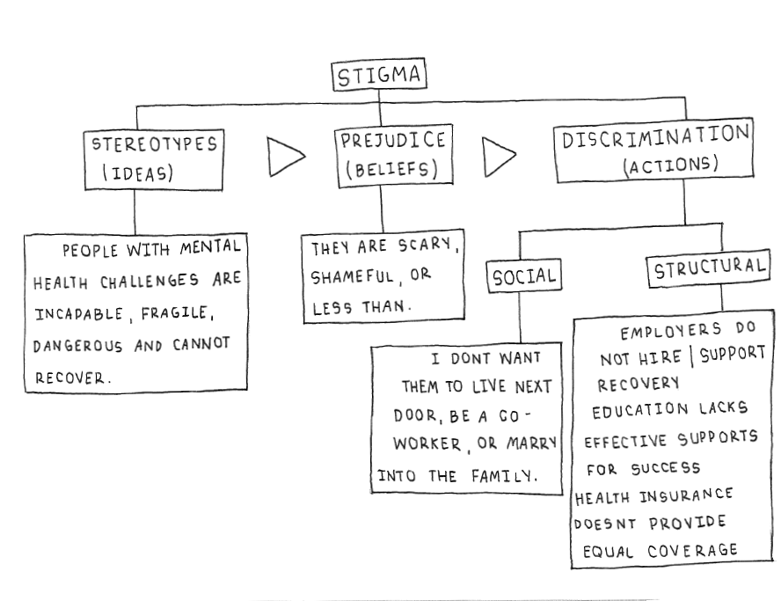
Stigma
(________________)
Image Credit: wisewisconsin.org/blog/what-is-stigma/

Slide 10
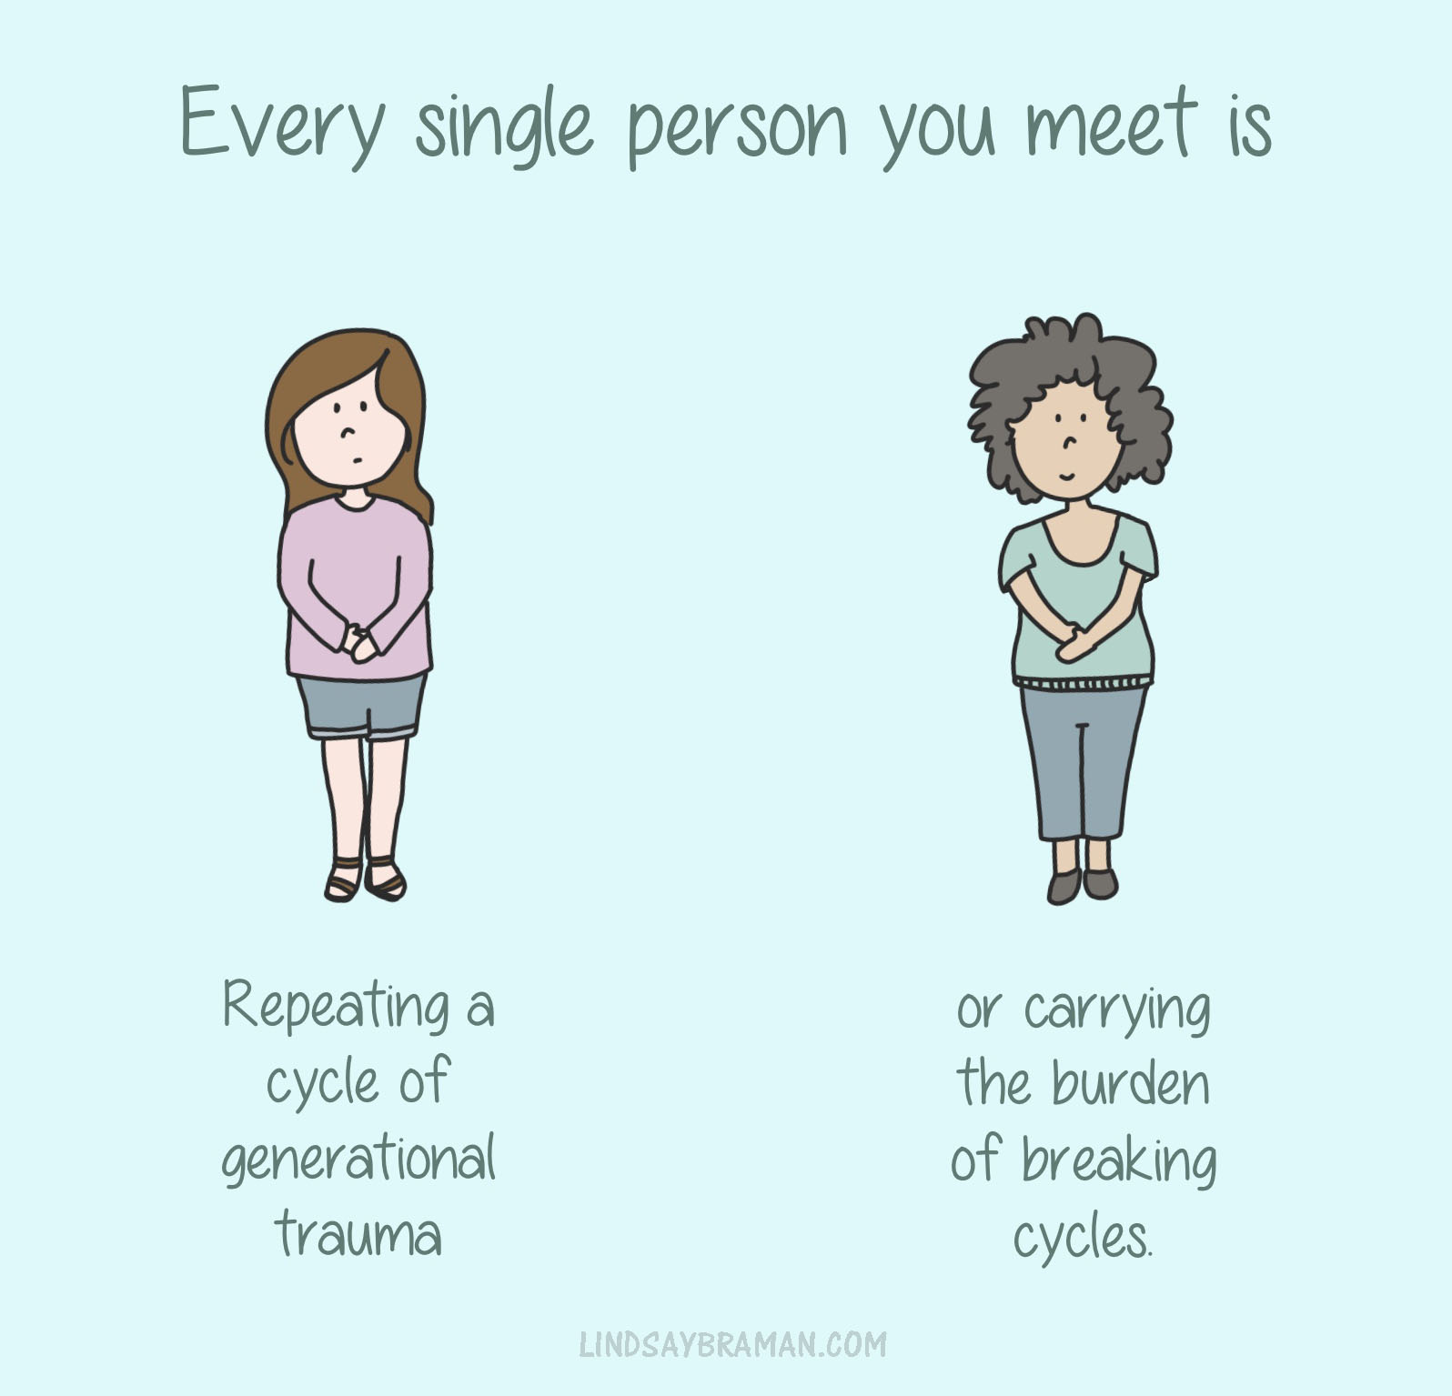
Collective trauma
Collective trauma is extraordinary in that it can bring distress and negative consequences to individuals and change the entire fabric of a community (Erikson, 1976)

Slide 11
Collective trauma
Impact on society
Collective trauma can impact relationships, alter policies and governmental processes, alter the way society functions and even change its social norms (Chang, 2017; Hirschberger, 2018; Saul, 2014).
Source: Jordan Hopkins/unsplash

Slide 12
Collective trauma
Impact on individuals
Illness Financial difficulties and poverty
Death Job loss
Changes to daily routine Increased violence
Social isolation Grief, confusion, distress, shame
Shelter in place Oppression, segregation
COVID 19 and the opioid crisis share similar effects

Slide 13
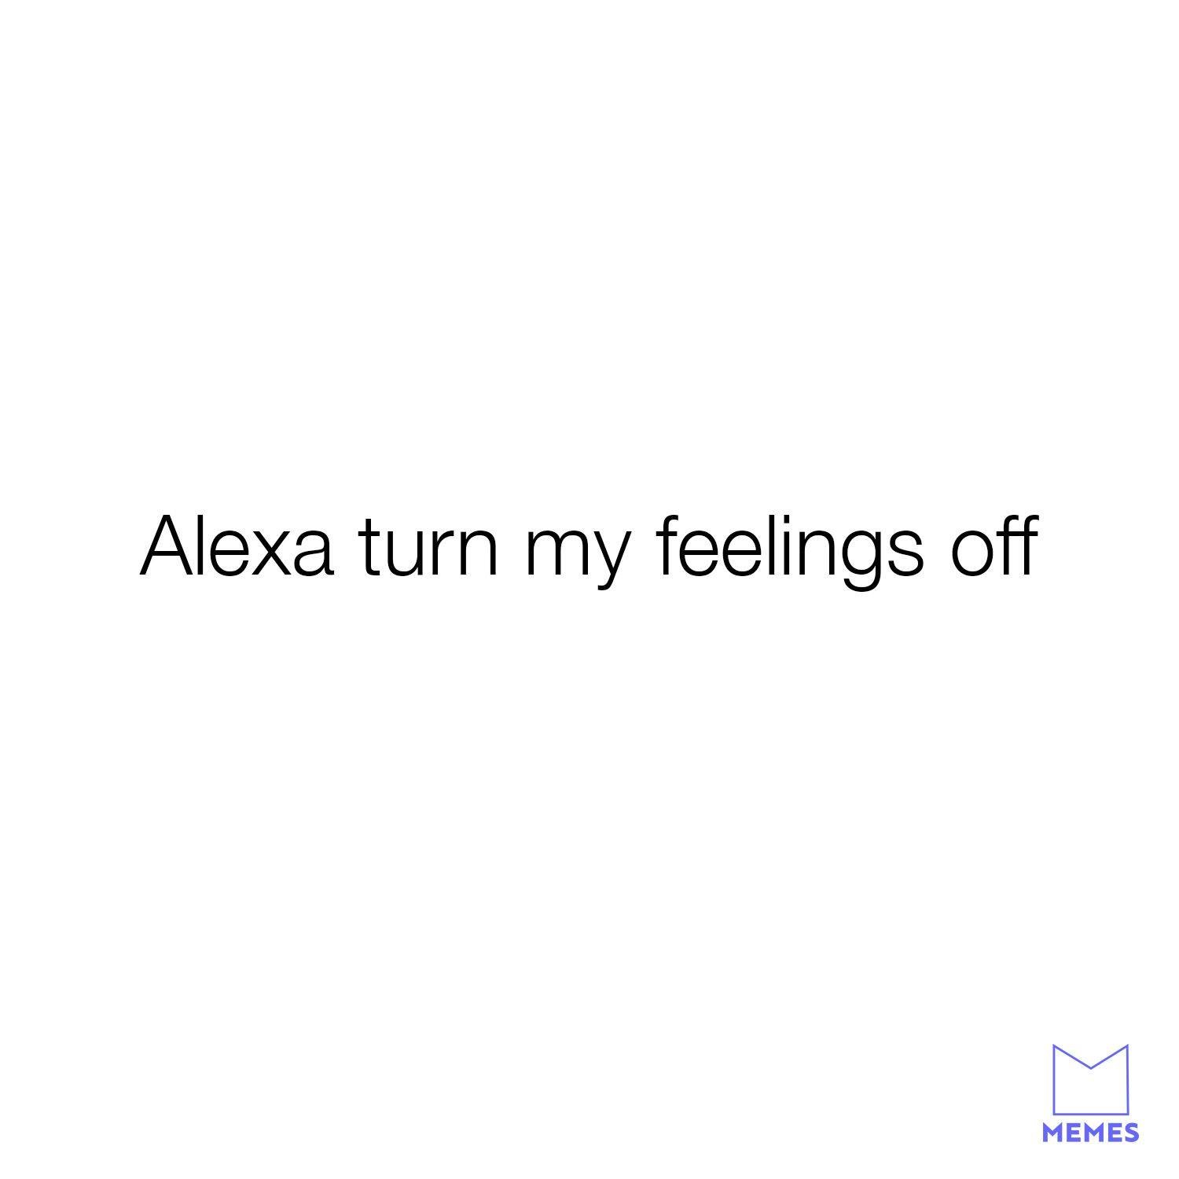
Case study
Erik + COVID 19
Has been feeling “off”
Watching the news and loved ones battling illness leaves him feeling helpless, depressed, and unmotivated
Most days he feels exhausted, plagued with headaches, and body aches
Old coping skills aren’t working anymore
Increasingly difficult to ask for help

Slide 14
Stigma and trauma threaten safety and survival.
Support builds internal motivation for change.

Slide 15
HARM REDUCTION

Slide 16
Holes in the safety net

Slide 17
The same level of consciousness
that gave rise to the war on drugs
won’t solve it

Slide 18
PRINCIPLES OF HARM REDUCTION
Health and Dignity
Participant Centered Services
Participant Involvement
Participant Autonomy
Sociocultural Competency
Pragmatism and Realism

Slide 19
Personal autonomy
Recovery is a process of change through which people improve their health and wellness, live a self-directed life, and strive to reach their full potential.
SAMHSA working definition of recovery, 2012

Slide 20
We are a movement
Harm Reduction
shifts power and resources to people
and communities most vulnerable to structural violence.

Slide 21
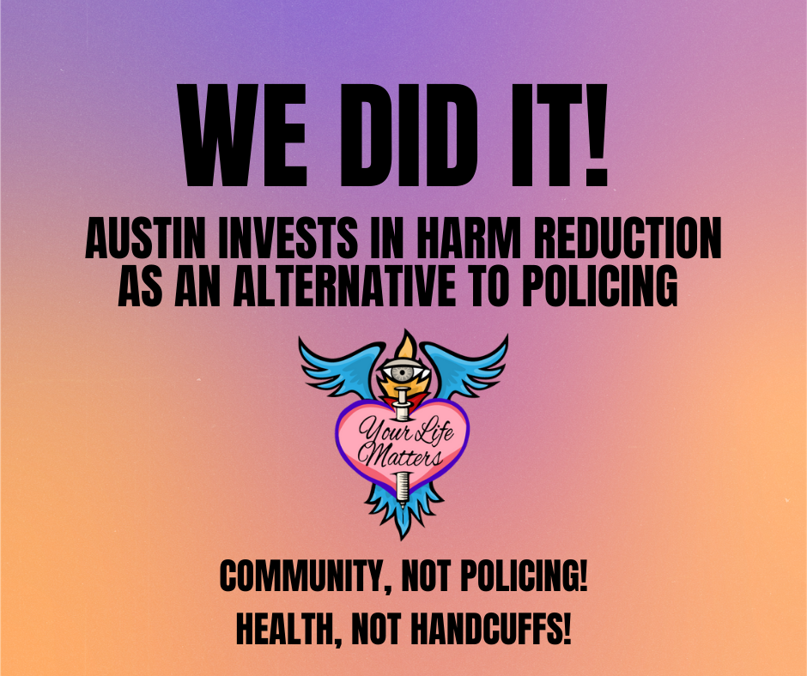
Signs of hope
Signs of progress

Slide 22
“We come from a tradition of being an alternative to mainstream systems public health and behavioral health systems, where racism and discrimination are also rampant. We see a future where cops do not hold this power or wield violence, where people who use drugs are treated with dignity and respect.” Joy Rucker Former ED, Austin Harm Reduction Alliance
(and New Bedford native!)

Slide 24
The greatest illusion in this world is the illusion of separation

Slide 25
#healthnothandcuffs #communitynotpolicing #harmreductionsaveslives
Thank you!
Monique Tula
Executive Director
tula@harmreduction.org
harmreduction.org
Copyright 2020 National Harm Reduction Coalition

